Slide 1

R and RStudio for statistics
(October 2023)
George Savva (QIB Institute Statistician)

Slide 2
Lesson Plan and Goals
Day 1 (In person, demo plus some hands on; break 2.30)
  Familiarity with R and Rstudio
  Tidyverse / Graphics
  Descriptives
Day 2 (Self-directed learning / with support)
  Finish day 1 work
  Tests
  Real data / cleaning and coding
Day 3 (In person)
  Modelling (fitting models, transformations, diagnostics, assumptions etc)
  More graphics
  Discussion

Slide 3
Aims
Introduction to R
Walk through basics of language and environment
Loading data / describing / hypothesis tests / graphics
Q&A. Ask me things!
Enough for you to
  go on Stats courses,
  continue self-directed learning,
  explore R for your own analyses
Being comfortable with R is the main goal.

Slide 4
Notes for today
Help each other
Introduce yourself
Introduce myself
Review files for the day
Schedule for the day.
We’ll learn by doing!
Why statistics?

Slide 5
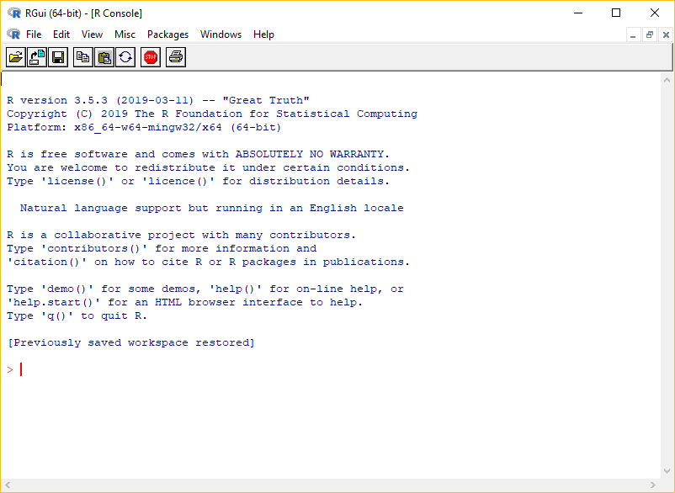
What are R and RStudio
R – Statistics package
R – Also the ‘language’ that you use to describe your analysis
‘R’ comes with the R console interface only.

Slide 6

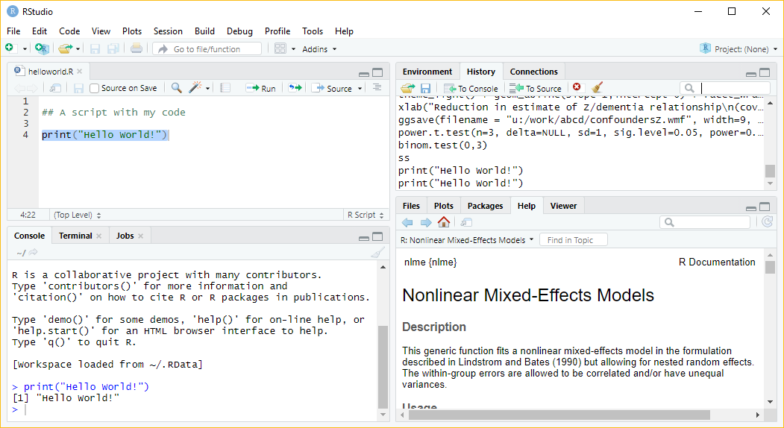

Slide 7

Why use R?
For your course:
Free and open source
Flexible and powerful: if it’s possible then it’s possible with R
Excellent graphical outputs
Great for sharing and reproducibility
Enormous friendly online community
Great transferrable skill!

Slide 8
R is different to Graphpad Prism / SPSS etc
For users of other packages:
You cannot use R without the documentation!
Everything is done in code using the R language
The code you write is the analysis
This is essential for reproducibility
For programmers:
R has its own quirks (eg vectorised function, ‘1’ indexed!) – spend some time learning it.

Slide 9
R is different to Graphpad / SPSS etc
R is for data cleaning / coding / analysis / reports
Workflow (https://rstats.wtf/)
  You keep data in its raw form (or as close as possible)
  We write R code to take raw data, wrangle, clean, code, analyse and report
  Keep the original data and the code!
  We typically don’t keep the processed data, or even results. At least we don’t need to.
Corollary – R is not for data entry or storage.
Raw data
(.xls, .csv, .txt,
database etc)
Load data
Clean / Wrangle
Explore /
Visualise / Model
Report (pdf, docx, html)

Slide 10
How to learn R
Use resources, books, websites, blogs, people and study the areas that you need.
Set aside time to learn.
Expect to use R with the documentation / community support open
Expect many error messages as you develop your code! This is normal!
Don’t ignore warnings!
Think about why R does what it does.
Learning R will improve your statistics – you will need to decide more things yourself, and using R promotes good practice

Slide 11
Packages - CRAN
Base R includes the language and basic statistics.
The great strength of R is its user written extensions ‘packages’
Eg: ggplot2 / data.table / tidyverse / (Bioconductor) / lme4 /
Also other systems that are built on R
  Shiny - Dynamic websites that run R code
  Rmarkdown / Quarto - Document preparation, make papers, presentations, blogs books.
New statistical ideas are written in R.
If anyone has ever wanted to do anything with data, there’s an R package for it. Probably several.
We’ll install and use a few add ons today

Slide 12
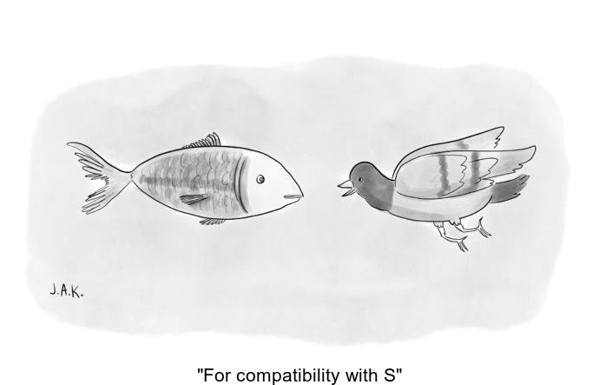
The ugly
Can be a little scary to start with
R has been developed with user written add-ons since the 1990s (1970s)
Many ways to do the same thing, many abandoned packages.
Eg ‘tidyverse’ vs ‘base’ vs ‘data.table’ ways of doing things.
Keeping up can be difficult..
But the community is great!
Credit: @whydoesR

Slide 13

Getting help

Slide 14
Sources of help 1 – R help system
Type
> help.start()
The manual has detail of the language, structures
Also documentation for each ‘base’ package and function.
Appendix A ‘a sample session’ is a useful walkthrough of common stats tasks
For each function (eg) type:
> ?mean

Slide 15
Sources of help 2 – RStudio and packages
https://education.rstudio.com/learn/beginner/
Good set of tutorials.
A bit ‘tidyverse’ oriented as made by the RStudio people!
Other websites, eg
  for metagenomics: https://joey711.github.io/phyloseq/

Slide 16
Sources of help 2 – Online resources
Phil Leftwich’s (BIO) Introduction to Statistics with R for Biologists and Ecologists
  https://philip-leftwich.github.io/physalia-stats-intro/index.html
Hadley Wickham’s books:
  R4DS – R for Data Science https://r4ds.had.co.nz/
  Advanced R https://adv-r.hadley.nz/
Danielle Navarro has made a lot of excellent resources available for free, including this book:
  https://learningstatisticswithr.com/
Modern Statistics for Modern Biologists (not an R book as such, but a lot of interesting uses of R throughout)
  https://www.huber.embl.de/msmb/
Software Carpentry – R for Reproducible Scientific Analysis
  https://swcarpentry.github.io/r-novice-gapminder/
R Cookbook:
  http://www.cookbook-r.com/
Big Book of R – 150 free online (or very cheap) R books
  https://www.bigbookofr.com/
https://rstats.wtf/ - Some very good tips for workflow development

Slide 17
Sources of help 3 – Online resources
‘Generic’ data/analysis issues:
Cheat Sheets:
  https://rstudio.com/resources/cheatsheets/
Specific analytic tasks:
CRAN Task View
  https://cran.r-project.org/web/views/

Slide 18
Other sources of help
Package vignettes
>vignette(“packagename”)
StackExchange (family of Q&A websites),
  stackoverflow.com for high quality R questions and answers
  Crossvalidated (stats.stackexchange.com) for statistics queries
Google “how do I …… in R”
Social media #rstats
Rbloggers
Me
Each other

Slide 19
Where next?
Quarto
reports and presentations
Git
version control
Tidyverse or data.table data wrangling
Bio-conductor
ggplot2 for graphics
R programming

Slide 20
Citing statistics software
For basic stuff, the answers will (hopefully) come out the same across packages.
For more complex things they may not
Each makes different assumptions, different algorithms
  There are many ways to get confidence intervals, standard errors in complex cases.
Syntax changes with package versions
So always specify which software you have used
And always cite the software and extra packages you used

Slide 21


Slide 22
Start RStudio!
I’ll walk you through:
  Making a new project
  An R script
  A Quarto report file
Then use the day 1 worksheet, and we’ll stop to revise after a break

