Slide 1
Statistics and experiments
George Savva
for Catton Primary School
International Maths Career Day

Slide 2
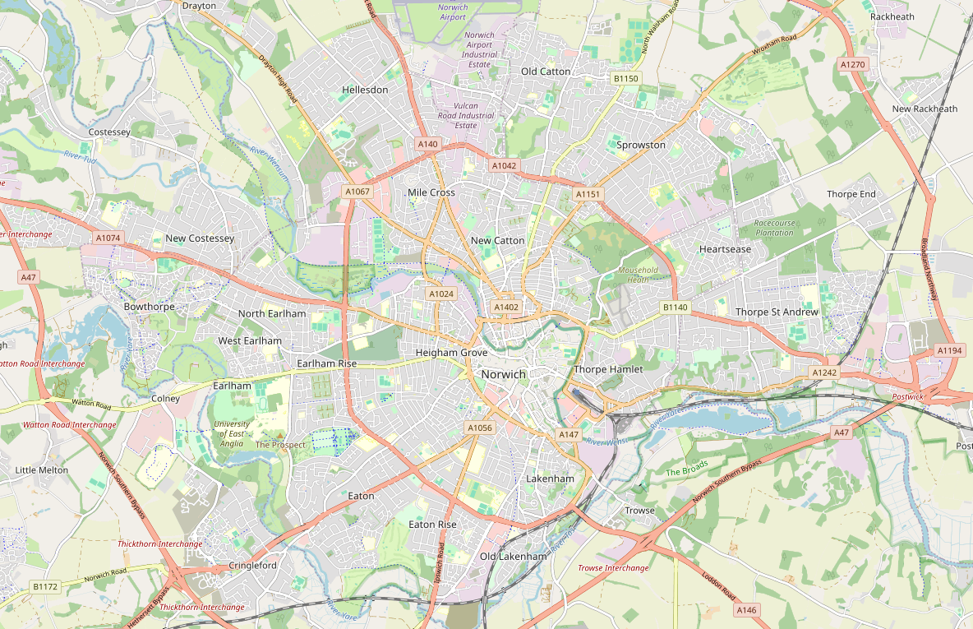
Norwich Research Park

Slide 3
Biology and medical schools
Plant science
Plant diseases
Hospital /
Medical research
Lots of science companies!
Genomics
Food and human health
Notes:
I work at the Quadram Institute, part of a big group of biological science institutes in beautiful setting just outside of Norwich.
At the John Innes Centre they study plants and plant diseases
We work on food science, bacteria and human health with doctors from the hospital.
We are close to the University of East Anglia, so students can work with us and it’s a great place to study if you’re interested in science.

Slide 4
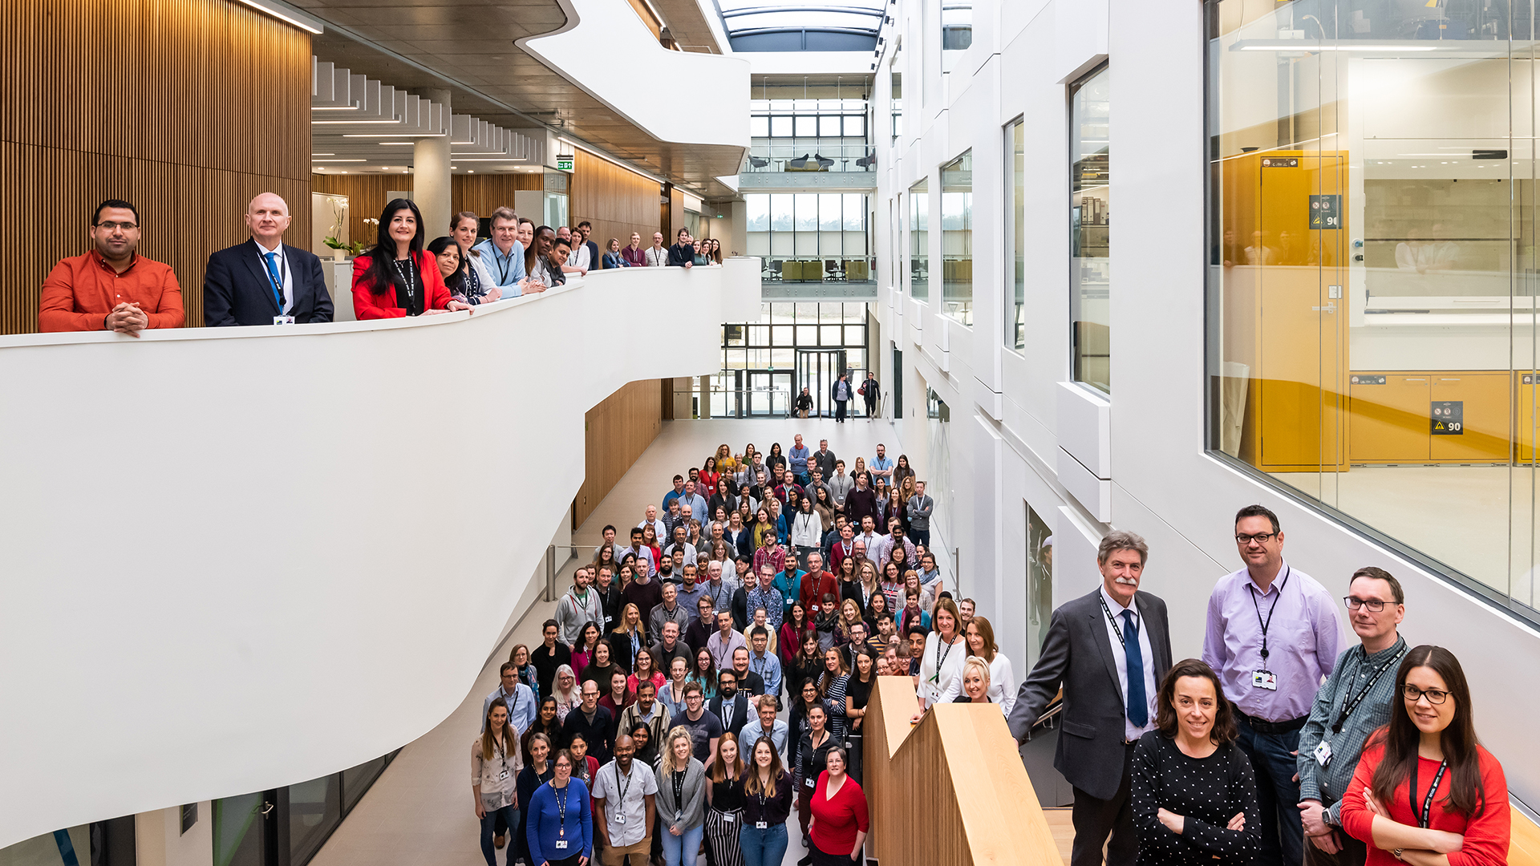
What do we do?
Can we make better sewage plants?
Can we design a product to support malnutrition recovery in children?
How can we measure brain health?
How can we support premature babies to survive
What causes Irritable Bowel Syndrome?
Can we diagnose bowel cancer faster?
How can we make bread healthy and delicious?

Slide 5
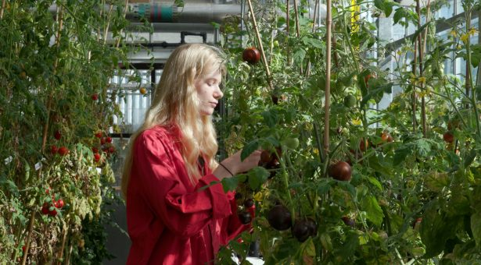
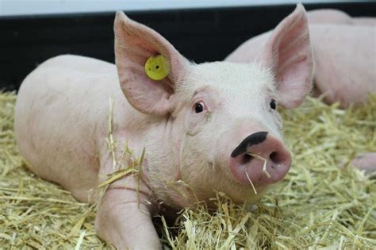
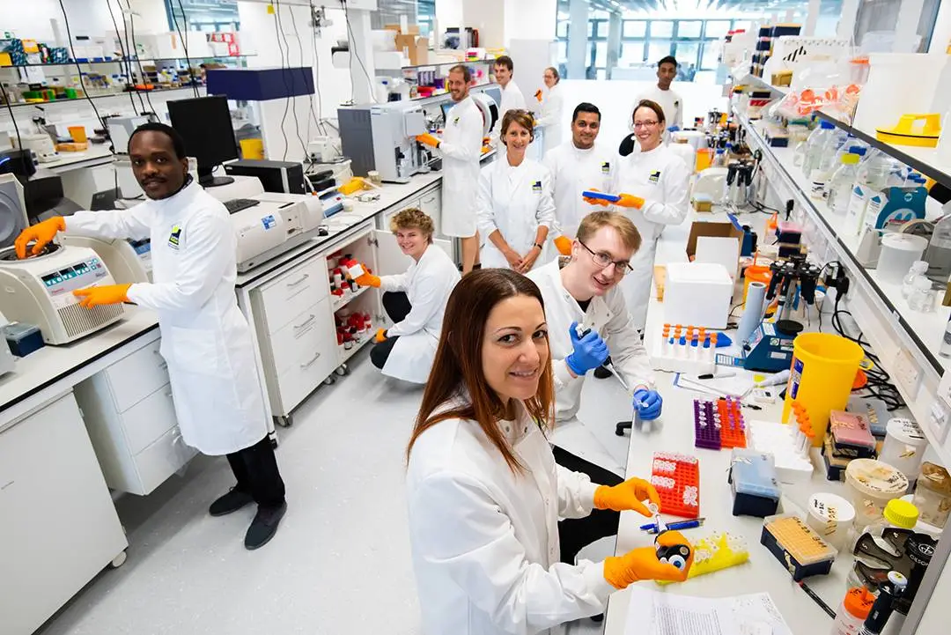
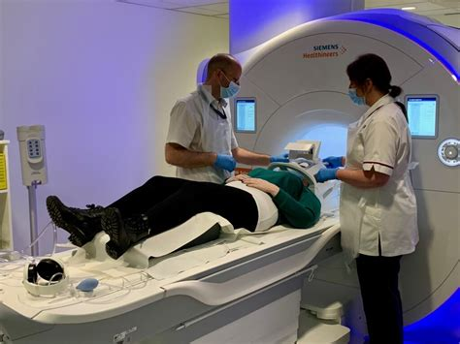
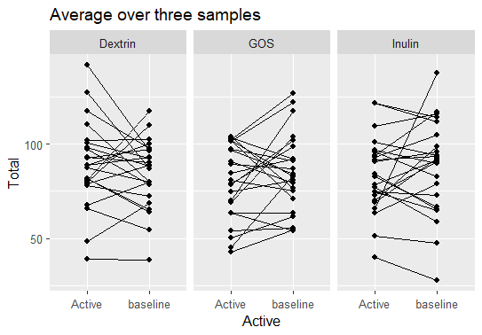
Maths, Statistics and science
I am the statistician at the Quadram Institute
I help scientists to design their experiments and to understand and communicate their results
Sometimes we do experiments where we ask people’s opinions about things (like new foods, or their health).
We need to ask questions carefully!
This is what we are thinking about today.

Slide 6
Todays work: How many coins In the jar?
We want to see how good you are at guessing the number of coins in a jar.
You will each guess how many coins there are.
Then we’ll summarise and compare the results between groups.
Task 1
Look carefully at the jar of coins.
Think about how many coins there are
Answer the questions on your worksheet!
Swap your worksheet with someone else in your group

Slide 7
Summarising and comparing data
Sometimes we gather a lot of data and we need to find a simple way to describe it.
We have collected guesses for two groups of around 15 people each
Lets fill it in!
Is there anything different about the guesses for each group.
How can we describe these sets numbers more easily?
Group 1 guesses
Group 2 guesses

Slide 8
Making graphs!
We want to simply communicate the important features of the data
What kind of questions could you ask about the data?
Task 2
Write down the guesses from your group in ascending order
(smallest to biggest)
The ‘median’ is the value in the middle
What is the median of your group’s values
How spread out are they?
How many points
What is the average?
Are there any crazy values?
What is the highest and lowest value?
Is one group ‘bigger’ than the other?
Was there anything different about the groups?

Slide 9
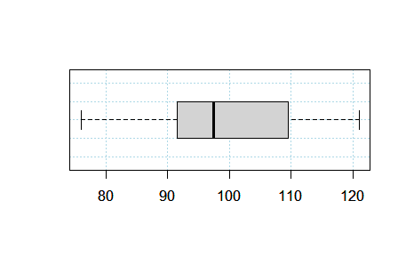
Box plots
Easy and effective way to quickly summarise a lot of information
Messy data
100, 98, 107, 99, 92, 91, 93, 115, 107, 99, 85, 100, 103, 103, 88, 100, 93, 105, 102, 100, 96, 100, 83, 109, 108, 95, 112, 97, 97, 109, 120, 117, 119, 95, 84, 105, 98, 92, 107, 106
Median
Min
Q1
Q3
Max
Sorted data
76, 80, 84, 88, 89, 89, 90, 91, 91, 91, 92, 92, 93, 95, 96, 96, 96, 96, 96, 97, 98, 102, 102, 103, 104, 104, 105, 105, 108, 109, 110, 110, 111, 111, 112, 112, 113, 117, 118, 121
‘Five number summary’
Minimum = 76
Q1 = 91.5
Median (Q2) = 97.5
Q3 = 109.5
Maximum = 121
Divide into four equal groups
76, 80, 84, 88, 89, 89, 90, 91, 91, 91,
92, 92, 93, 95, 96, 96, 96, 96, 96, 97,
98, 102, 102, 103, 104, 104, 105, 105, 108, 109, 110, 110, 111, 111, 112, 112, 113, 117, 118, 121

Slide 10
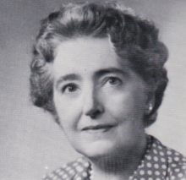
Box plots (if we have time!)
Box plots were first described by Mary Eleanor Spear in 1952.
How to make box plots
Divide the ordered data for your group into four equally sized parts
Find the values that separate the groups
Get the ‘five-number summary’: Minimum, Q1, Median (Q2), Q3, Maximum
Make a suitable scale
Draw the range (min-max), the box (Q1-Q3) and the median!
“Visual information specialist”

Slide 11
‘Anchoring bias’
£5
£3.50
Relying on the first piece of information we see when making judgements
Make somebody think of something and it is very hard to make them forget it.
We need to avoid this in research!
So we must be very careful about how we ask things!
But in other cases, people might try to use anchoring bias. Can you think of some examples?
£3.50
Shops can use ‘anchoring’ to make you think something is worth more than it is

